Slide 1



DBMS Assignment 1
Design and Implementation of a database management system for Research Project, Publication and Grant Management System
By: M S Chethana
25WU0102142

Slide 2

Problem Statement
Research-related information is often maintained across separate files and systems.
  No single view of overall project progress
  Grant and funding details may be scattered across records.
  Project milestones and expenditure are difficult to track.
  Manual data management can lead to duplication, inconsistency and missing information.

Slide 3
Proposed solution to the problem statement.
A centralized relational database system that connects researchers, projects, funding, milestones, expenditure and research outputs.

Slide 4
Project Objectives
  Centralize research project-related information.
  Maintain researcher and department records.
  Manage projects and investigator assignments.
  Track grants, funding agencies and budgets.
  Monitor project milestones and expenditure.
  Link projects with publications and patents.
  Generate meaningful research and funding reports.
  Maintain data integrity and consistency through relational database design.

Slide 5



Scope of the System
The database will cover the complete research management lifecycle:
researchers
projects
grant agencies
departments
milestones
publications/
patent
reports

Slide 6
Scope of the Project
  Register and maintain researcher, department and project details.
  Assign investigators to research projects.
  Manage funding agencies, grants and project budgets.
  Track project milestones and completion status.
  Record and monitor project expenditure and budget utilization.
  Manage research publications, patents and reports.
  Retrieve research information and generate project, funding and research-output reports.

Slide 7
System Users
1. Researcher
  View assigned projects
  Track project milestones
  Edit research outputs & Access publication information
2. Administrator
  Register projects and researchers
  Assign investigators
  Manage grants and funding
  Record milestones & Generate reports
3. Department
  Monitor, Track and Review the research outputs

Slide 8
Functional Requirements
The system should allow authorized users to:
  Register researchers and departments
  Create and manage research projects
  Assign investigators to projects
  Register funding agencies
  Record grants and project budgets
  Define and track milestones
  Record project expenditure
  Link publications to projects
  Maintain patent information
  Generate research and funding reports

Slide 9
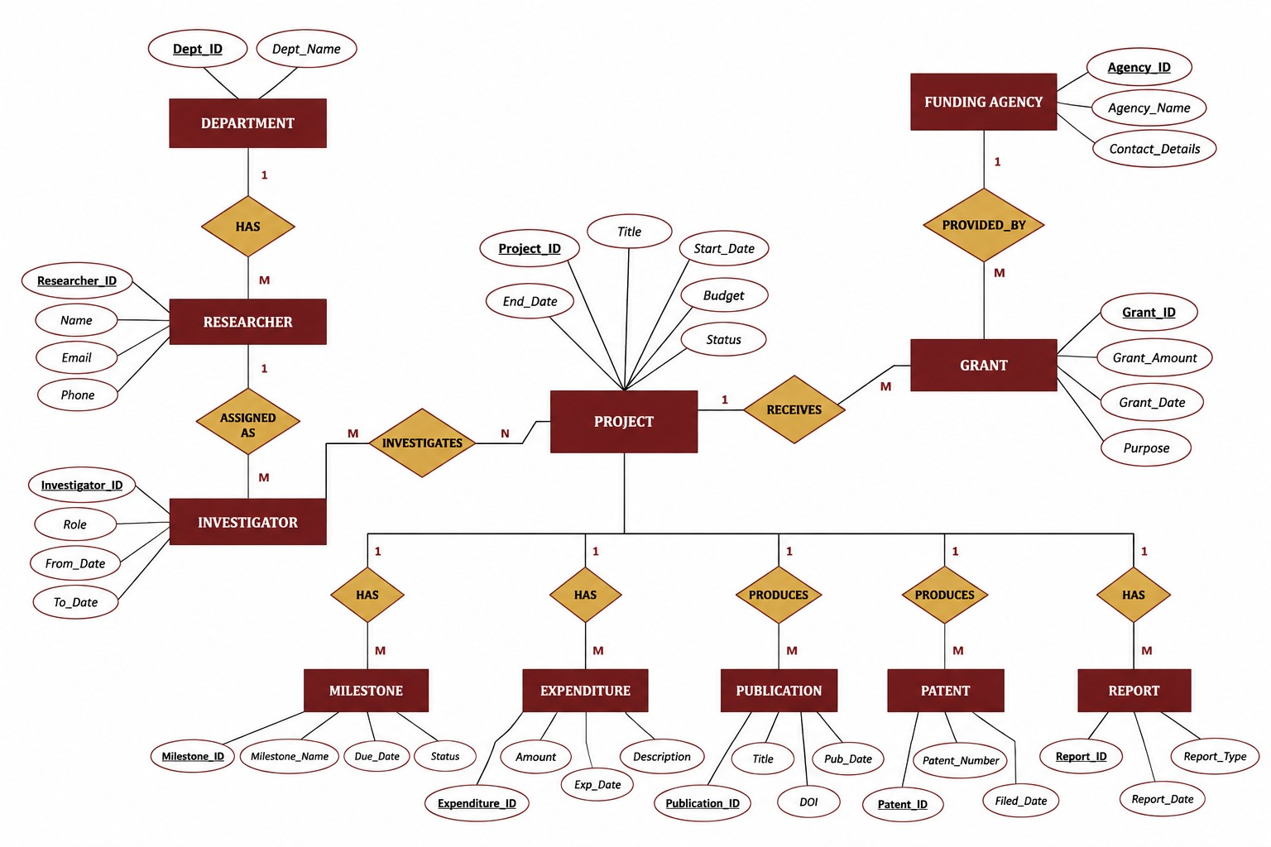
Conceptual ER Diagram

Slide 10
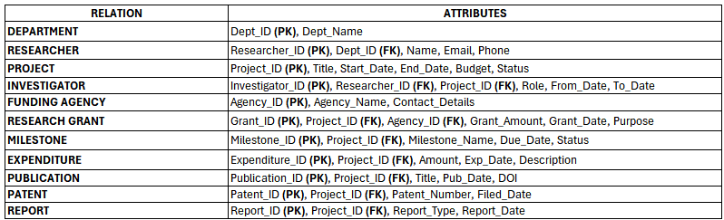
Relational Schema

Slide 11
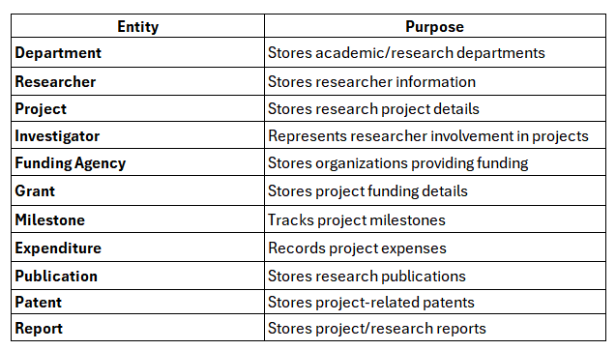
Main Entities

Slide 12
Thank You
(review 1)

